Slide 1
Opiate Medication Concerns
The Physicians’ Spine and Rehabilitation Specialists of GA
Keith Raziano, M.D.
Paul Mefferd, D.O.

Slide 2
Pain can be a symptom…

Slide 3
…or not.

Slide 4
Chronic Pain Syndrome

Slide 5
Sometimes identification of the pain generator can be difficult

Slide 6
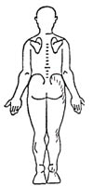
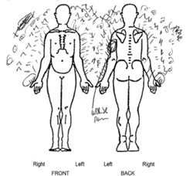
Which is easier to diagnose?

Slide 7
Two Forms of Pain Management
Palliative
Focus on Pain
Patient controlled
Pain behaviors valid/productive
Opiate drugs often indicated
Physical and behavioral rehabilitation optional
Rehabilitative
Focus on Function
Physician controlled
Pain behaviors not valid/counterproductive
Opiate drugs have limited/no indication
Physical and behavioral rehabilitation encouraged

Slide 8
The Facts about Opiates
Efficacy only in acute/malignant pain
No efficacy in chronic non-malignant pain >13 months
High doses/long term use may cause increased pain
Multiple side effects that impair function
Abuse and diversion of prescription opiates is causing a national healthcare crisis

Slide 9
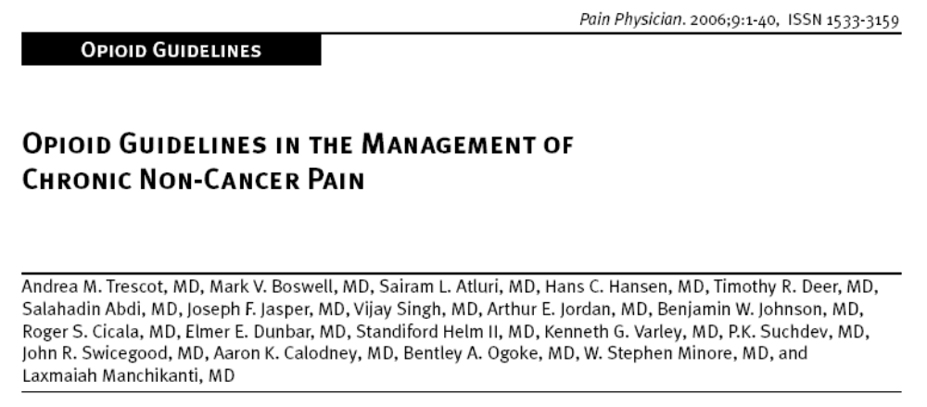
Evidence was designated based on
Scientific merit as Level I (conclusive), Level II (strong), Level III (moderate), Level IV (limited), or Level V (indeterminate).
Results: After an extensive review and
analysis of the literature, the authors utilized two systematic reviews, two narrative reviews, 32 studies included in prior systematic reviews, and 10 additional studies in the synthesis of evidence. The evidence was limited.

Slide 10
Studies
“…Average claim costs of workers receiving seven or more opioid prescriptions were 3 times more expensive than those of workers who receive zero or one opioid prescription, and these workers were 2.7 times more likely to be off work and had 4.7 times as many days off work.”
  -- Gardner, Laura, MD, Pain Management and the Use of Opioids in the Treatment of Back Conditions in the California Workers’ Compensation System, June, 2008

Slide 11
Studies (cont.)
“Early use of higher morphine equivalent amounts of opiates in acute LBP was significantly associated with worse long-term outcomes, including prolonged disability, increased medical utilization, including surgery, and continued opioid use.”
  -- Webster, Barbara, BSPT, PA-C, Relationship Between Early Opioid Prescribing for Acute Occupational Low Back Pain and Disability Duration, Medical Costs, Subsequent Surgery and Late Opioid Use; SPINE, Vol. 32, No. 19, pp 2127-2132, 2007.

Slide 12
Effects of Opiates
Initial:
  Pain relief
  Euphoria
  Relaxation
  Constipation
  Dizziness
  Nausea/Vomiting
  Itching
  Dry Mouth
  Mentation changes
Intermediate (> 7 Days)
  Tolerance begins within hours to days
  Decreasing efficacy
    Less pain relief
    Duration of pain relief reduced
  Irritability
  Sleep disturbances
  Continued cognitive impairment

Slide 13
Effects of Opiates
Chronic (> 6 months)
  Tolerance escalates
  Dependence
  Insomnia resistant to sleep-aids
  Personality and behavioral changes
    Aggression
    Irritability
    Depression
Hormone changes
  Subnormal Testosterone levels in men
Immune suppression
  Macrophage and lymphocyte compromise
Higher rates of disability
Impairment operating vehicles/machinery
Increased sensitivity to painful stimuli

Slide 14
Neurophysiologic effects of Opiates
Analgesia
Early hyperalgesia (hours)
Acute cross tolerance to analgesic effects of other opiates
Delayed hyperalgesia (days)
Development of Opiate- Induced Hyperalgesia

Slide 15
Opiate-Induced Hyperalgesia
Glial cells are responsible for normal nerve function and care
In chronic pain, glial cells can become over-sensitized and cause nerves to feel pain more easily
Pain is also triggered by stimuli not normally painful
This sensitization is worsened with prolonged opiate usage

Slide 16
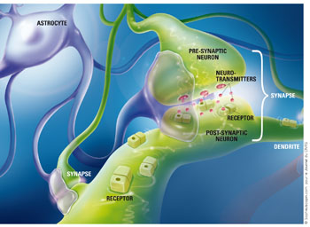
Take Home Message
The “old” way of thinking: Increase pain medication until pain is relieved or the side-effects become too great
The “new” way of thinking is to limit opiates
Solution: Wean off those who are on high dose, long-term opiates

Slide 17
How Did We Get Here?
Did something change? Are we a culture that believes there is a drug for everything?

Slide 18
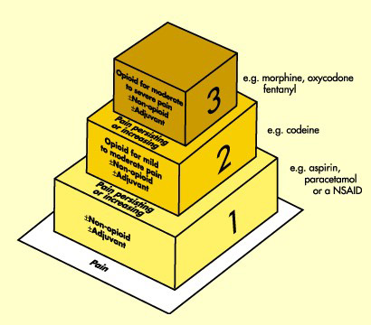
Pharmacologic Treatment Pyramid
WHO -- 1996
Was developed for acute pain and chronic malignant pain
Ignores other modalities
  Physical therapy
  Behavioral
  Therapeutic interventions

Slide 19
Pain as a Vital Sign
World Health Organization encouraged pain levels be addressed at every visit
Attorneys filed lawsuits for patients claiming their pain was inadequately addressed
Significant increase in opiate prescriptions
Many primary care physicians got in over their heads
Prescriptions for dangerous and often poorly understood medications like Oxycontin and Methadone became common

Slide 20

When one problem turns into another….

Slide 21

Drug Treatment:
How much is too much?
Pain out of proportion to objective findings
Request for increase in dose/frequency despite lack of efficacy
High doses of opiates, but still high VAS scores
Addiction/diversion behaviors
  Substance abuse
  Early refills/lost rx

Slide 22
Is There a Problem?
United States
  4.6% of world’s population
    2007: ~301 million
  Utilizes 80% of the world’s prescription opioids
    Trescot et al. Pain Physician 2006; 9:1-39.
  “Pill-Mills” originated in Florida (George Brothers)
    Migrating north
    Lucrative, pseudo-legal drug-dealing
    Barrels of excess cash burned in back
    Rampant drug abuse and selling

Slide 23
Retail Sales of Opiates (grams)
 | 1997 | 2005 | % Change
Methadone | 518,737 | 5,362,815 | 933%
Oxycodone | 4,449,562 | 30,628,973 | 588%
Fentanyl | 74,086 | 387,928 | 423%
Hydromorphone | 241,078 | 781,287 | 244%
Hydrocodone | 8,669,311 | 25,803,544 | 198%
Morphine | 5,922,872 | 15,054,846 | 154%
Meperidine | 5,765,954 | 4,272,520 | -26%
Codeine | 25,071,410 | 18,960,038 | -24%

Slide 24
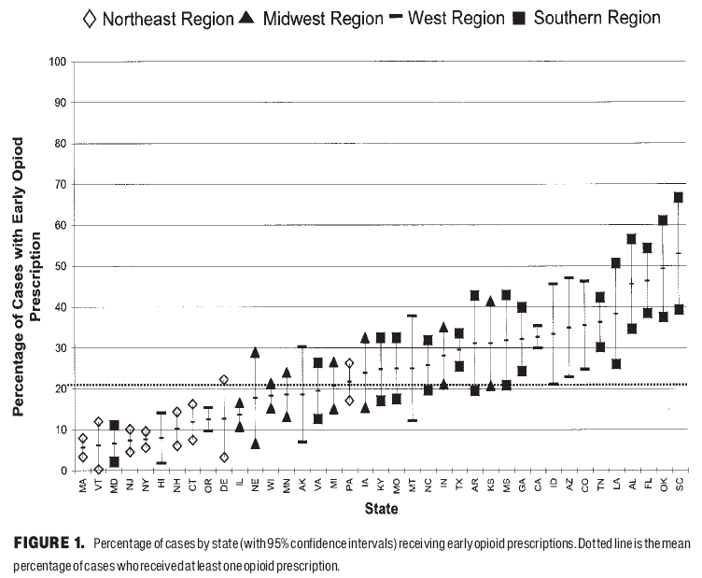
Opiate Usage Per Region

Slide 25
Death by Overdose
The death rate for prescription drugs increased 84.2%, from 7.3 to 13.4 per 100,000 population from 2003 to 2009 in Florida alone
In 2009, 28,000 deaths occurred in the U.S. due to overdose of prescription opiates (One person overdoses every 19 minutes)
Oxycodone is the number one prescription drug killer
  Why did the FDA take Darvocet off the market?
  Vioxx? Double the risk of cardiovascular event than Advil.

Slide 26
Pain Management is a Black Hole!
If you’re a pain physician in the Worker’s Compensation arena, you are viewed as the enemy. We want to change that perception.

Slide 27
Multidisciplinary Approach
Structured Pain Management Options
  Structured plan
    Focus on intervention and rehabilitation
    Narcotic agreement
    Appropriate psychological involvement
    Routine follow up
    Routine screening
    BOUNDARY ESTABLISHMENT
Interventional Procedures
  Epidural Steroid Injections
    Transforaminal
    Translaminar
  Facet Joint Injections
  Radiofrequency Neurotomy
  Discograms
  Spinal Cord Stimulation
    There are some who will benefit, but…
    Carries a very high cost and limits settlement in the Work Comp arena
    Rarely recommended in Worker’s Compensation

Slide 28
Our Goal:
We practice with function and return to work in mind.
We do not prescribe long-term opiates when at all possible
Early intervention and rehabilitation!
Limit medications
Limit costs
Use generic whenever possible
Facilitate an end to a case and prevent the “black hole” so commonly seen in Pain mgmt
Take over “old cases” and achieve MMI and settle

Slide 29
Medication Quiz!
Column One
Column Two
OxyContin 40 mg Q8h
Lyrica 150 mg Q12h
Lidoderm Patches 2 Daily
Cymbalta 60 mg Q12h
Oxycodone 30 mg Q6h
Gabapentin 300 mg Q8h
Lidocaine Ointment Q8h
Fluoxetine 20 mg Daily
Nortriptyline 50 mg Daily

Slide 30
Column One
OxyContin 40mg Q8h = $700 per month
Lyrica 150 mg Q12h = $200 per month
Lidoderm Patches (2) = $700 per month
Cymbalta 60 mg Q12h = $500 per month

Slide 31
Column Two
Oxycodone 30 mg Q6h = $200 per month
Gabapentin 300 mg Q8h = $35 per month
Lidocaine Ointment = $60 per month
Fluoxetine 20 mg QD = $25 per month
Nortriptyline 50 mg QD = $25 per month

Slide 32
Side-by-Side
Column One
Column Two
Brand name medications
  $2100 per month!
  $25,200 per year
Generic medications
  $345 per month!
  $4,140 per year

Slide 33
Wrap Up
The goal is to treat early and concentrate on FUNCTION rather than symptom relief
Limit opiate medications as much as possible early in the injury
Wean those who are on high dose, chronic opiates
Limit the cost of other medications
Return to work!

Slide 34
Locations
Keith Raziano, M.D.
  5730 Glenridge Drive, Suite 100
  Sandy Springs, GA 30328
  404-816-3000 (phone)
  678-904-5797 (fax)
  kraziano@thephysicians.com
  Paul Mefferd, D.O.
  790 Church Street, Suite 550
  Marietta, GA 30060
  770-419-9902 (phone)
  770-419-7457 (fax)
  pmefferd@thephysicians.com

Slide 35
References
Loeser JD, Melack R. Pain: an overview. The Lancet.1999; 353:1607-1609.
Parrott T. Using opioid analgesics to manage chronic noncancer pain in primary care. J Am Board Fam Pract. 1999;12(4):293-306.
Jacobson L, Mariano AJ. Chapter 10: General considerations of chronic pain, Bonica’s Management of Pain. 3rd ed. Loeser JD, Butler SH, Turk DC, et al. (eds.). Lippincott, Williams & Wilkins, 2000:241-254.
Doleys DM, Olson K. Psychological assessment and intervention in implantable pain therapies. Medtronic Brochure. 1996.
Finley RS. Treating chronic nonmalignant pain: issues and misconceptions. U.S. Pharamist. ACPE Program No. 430-000-02-09-H01. (released Sept. 2002)
6. Katz J. Lumbar disc disorders and low-back pain: socioeconomic factors and consequences. J Bone Joint Surg. Am. 2006;88:21 - 24.
7. Paice JA, Penn RD, Shott S. Intraspinal morphine for chronic pain: a retrospective, multicenter study. J Pain Symp Mgmt. 1996. 11(2):71-80.

Slide 36
References (continued)
6. Katz J. Lumbar disc disorders and low-back pain: socioeconomic factors and consequences. J Bone Joint Surg. Am. 2006;88:21 - 24.
7. Paice JA, Penn RD, Shott S. Intraspinal morphine for chronic pain: a retrospective, multicenter study. J Pain Symp Mgmt. 1996. 11(2):71-80.
Centers for Disease Control; CDC Grand Rounds: Prescription Drug Overdoses – A U.S. Epidemic; Morbidity and Mortality Weekly Report, January 13, 2012

