Slide 1

October 2013
BMW MC Prevention Programs 2013.
Early Intervention Process overview

Slide 2
BMW MC Prevention Programs 2013
Occupational health approach
BMW MC employs a cradle-to-grave approach with our associates:
  Pre-placement activities
  Ergonomics/Safety Systems (ABATech)
  Job Rotations
  Early Intervention Process (EIP)
  Aggressive Claims Management (as BMW MC is financially responsible for work related injuries)

Slide 3
BMW MC Prevention Programs 2013
Early Intervention Process (EIP) Background
The EIP process, introduced in Body Shop in 2009 is now up to six full-time EIP Physical Therapists.
Physical Therapists work with any Team Member, on the shop floor, who may be experiencing discomfort.
Benefits of the EIP include:
  Improved Team Member Morale (illustrates we are actively caring for their ergonomic wellbeing)
  Improved Attendance (as Team Members are able to remain working)
  Reduced Injury Frequency
  Reduced Injury Severity (as medical intervention is occurring earlier in the injury mechanism process).
  Reduced injury costs.
  Converts a culture from a “breakdown” model to a “healthy” Team Member model.
  Reinforces our commitment to our Team Members.

Slide 4
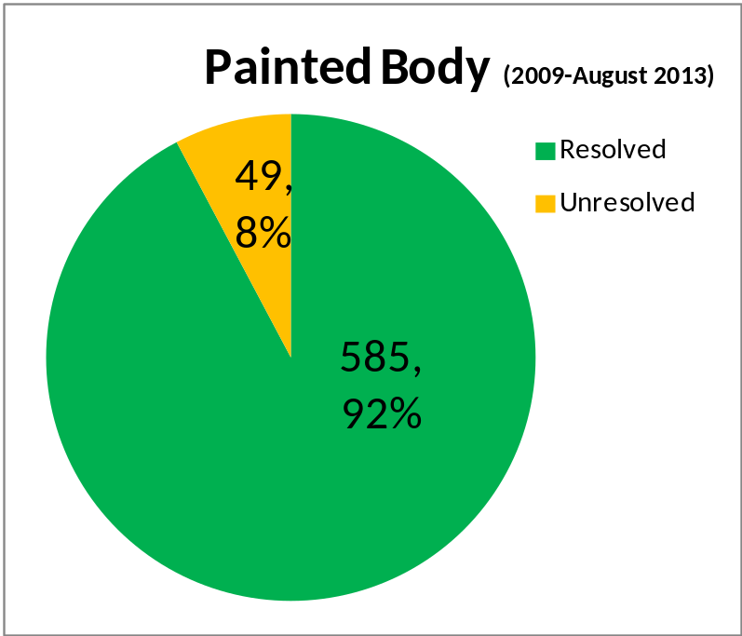
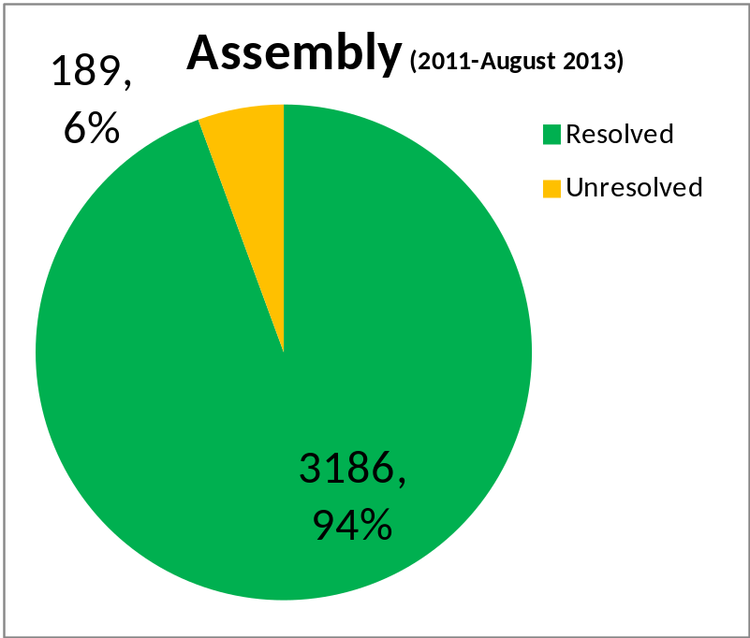
BMW MC Prevention Programs 2013
Early Intervention Process Summary
Charts summarize outcomes of Team Members who have participated in the EIP process since its inception in Painted Body (2009) and Assembly (2011).
Overall, ~4000 associates have participated in the EIP and 94% have realized successful outcomes (resolution of symptoms).
For BMW MC, the EIP is a key component to our continuous improvement efforts on sustainability, being an attractive workplace, cost competitiveness, and issue free strategy.

