Slide 1
Professional Ethics in Case Management
SCWECA
October 15, 2012
Notes:
Always leave content on cover slide as right-justified
Decrease the font point size or resize the text box if the text becomes too long and overlays the green pyramid design – text should never touch the green pyramid stripes

Slide 2
Program Objectives
Definition of Ethics
Laws and Codes of Ethics
Ethical Dilemmas
Top Ethics Traps

Slide 3
It’s All About Ethics!
“ Man cannot pretend to be higher in ethics, spirituality, advancement, or civilization than other creatures, and at the same time live by lower standards than the vulture or hyena”
- H. Jay Dinsah

Slide 4

Ethics
Ethics can be defined broadly as
a set of moral principles or values.
Each of us has our own a set of morals and values.

Slide 5

Distinguishing Morally Good from Morally Bad

Slide 6
Ethical Issues
Different Backgrounds
Different Life Experiences
Different Points of View/Biases
Different Expectations
Different levels of consciousness

Slide 7
Simply Put
There is no real separation between our Professional Ethics and our Personal Ethics.
Ethics involves “LEARNING” what is right or wrong “AND DOING” what is right or wrong”.
Out of fear of legal repercussions, social rejection or economic stability, most of us choose to do the right thing.

Slide 8
Professional Ethics
Establishes a specific set of criteria and standards for distinguishing between what is morally good or morally bad.
Our society has attached a special
meaning to the term professional
A professional is expected to conduct
himself or herself at a higher level
than most other members of society.

Slide 9


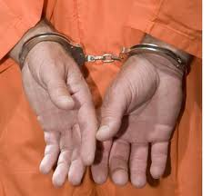
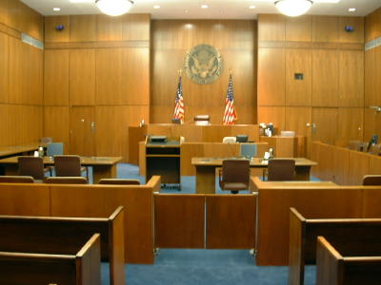
Laws and Ethics
Is there a difference?

Slide 10
A Person’s Ethical Standards
Differ from General Society
Embezzlers
Con artists
Shoplifters
Most people who commit such acts feel no
remorse when they are apprehended because
their ethical standards differ from those of
society as a whole.

Slide 11
What Would You Do?
A Person ( not you) finds a briefcase containing
important papers and $10,000.
He tosses the briefcase and keeps the money.
He brags to his friends about his good fortune.
This action probably differs from most of society.

Slide 12
Rationalizing
Unethical Behavior
Everybody does it.
If it’s legal, it’s ethical.
Likelihood of discovery and consequences

Slide 13
Ethical Issues and Case Management
How do you keep a client-focused approach, provide quality service and still meet the company and customer objectives?
Can you satisfy all parties involved without breaking the rules?
Sometimes breaking a rule is just how business is done.

Slide 14
Keys to Professional Ethical Behavior
Practicing acceptable personal behavior.
Must be based on FAIRNESS. Always negotiate or act in good faith.
Requires Integrity. This refers to reliability and consistency. Treat people with respect and honesty. Ethical professionals back up their promises and they keep their commitments.
Require Telling the TRUTH. In most cases, telling the truth is not only the law, ethics requires it.

Slide 15

Code of Ethics
Do You Know What They Are?

Slide 16
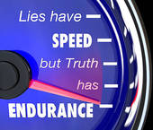
Ethical Dilemmas
An ethical dilemma is a situation a
person faces in which a decision must
be made about appropriate behavior.

Slide 17
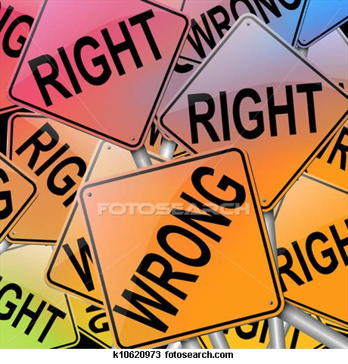
What Would You Do?

Slide 18
Top Ethics Traps
Not Knowing the Code of Ethics and the Issues surrounding them. You can’t adhere to what you don’t know.
KNOW…………Learn………Code of Ethics….Law

Slide 19
Improper Professional/Client Relationships
Don’t Be Vague
Keep the Boundaries Clear. No involvement in personal or business relationships.
JUST DON’T DO IT!!!!!
#1 Reason for REVOCATION of CREDENTIALS/LICENSURE

Slide 20
Overlooking the Marketing/Gratuity Rules
As a general rule, don’t accept anything that can’t be shared with ALL of your coworkers, customers.
And NO, it doesn’t matter how small or inexpensive the item may be!

Slide 21
My Boss Made Me Do It
”I did it because I was directed to do it” is never a defense to wrongdoing
UNLESS
It is an act of a reasonable resolution of an arguable question of professional duty

Slide 22
Disclosure
Failure to disclose role, relationship or purpose
Presenting a false statement of intent
Failure to notify other parties of a potential conflict of interest.

Slide 23
Privacy and Confidentiality
Improper Disclosure
Improper Use
Information obtained in the course of the professional relationship should not be disclosed to third-parties without obtaining the client’s permission.

Slide 24
COMMUNICATION
Be careful to choose the best method of communication.
Make sure that ALL forms of communication are clear and factual.
In most situations, it is best to not only say it but to write it
DOCUMENTATION TRUMPS CONVERSATION EVERYTIME!

Slide 25
Obligatory Disclosure
Terrorism
Treason
Money Laundering
Drug Trafficking
To report substantiated homicidal/suicidal ideation.

Slide 26
Conflict of Interest
A person who acquires information in the course of his or her professional work should neither use nor appear to use information for his/her personal advantage or for the advantage of a third party.

Slide 27
Integrity and Competence
Integrity should be maintained in all professional, business and personal relationships. It implies honesty, fair-dealing and truthfulness.
One should not accept work which cannot be competently undertaken.
Professional work should be performed with due skill, care, diligence, objectivity and expedition.

Slide 28
Do the Right Thing
Have the courage to say no. Have the courage to face the truth. Do the right thing because it is right. These are the magic keys to living your life with integrity.”
EVERYBODY wins when all parties behave professionally and ethically.

Slide 29
Final Thought
“ETHICS IS KNOWING THE DIFFERENCE IN WHAT YOU HAVE A RIGHT TO DO AND WHAT IS RIGHT TO DO”
-Albert Schweitzer
“RELATIVITY APPLIES TO PHYSICS NOT ETHICS”
-Albert Einstein

Slide 30

THANKS FOR COMING!

